Slide 1
E-commerce Platform
Here is where our presentation begins

Slide 2




Our team
Saikat Barua
Jaman Taif
Jahirul Islam
2104010202196
2104010202209
2104010202213
Ismail Hossain
2104010202210

Slide 3
Table of contents
1
4
2
5
3
6
Introduction
Methodology
Motivation
Output
Features
Limitions & Future works

Slide 4
Introduction
E-commerce platforms have become essential for businesses in the digital age, serving as online marketplaces that enable the buying and selling of products and services. They provide businesses with a digital storefront where customers can browse, purchase, and track orders seamlessly.

Slide 5
Motivation
The motivation behind using e-commerce platforms is rooted in the growing global trend of online shopping. As more consumers turn to the internet for convenience, businesses are able to scale rapidly by operating online. E-commerce platforms allow companies to be available 24/7, ensuring that customers can shop at any time, from anywhere in the world.

Slide 6
Features
Product Management
Shopping Cart
Online Payment
Order Processing
Search & Navigation
Bill Generate

Slide 7
Methodology
Database Design
Workflow
Use Case Diagram

Slide 8
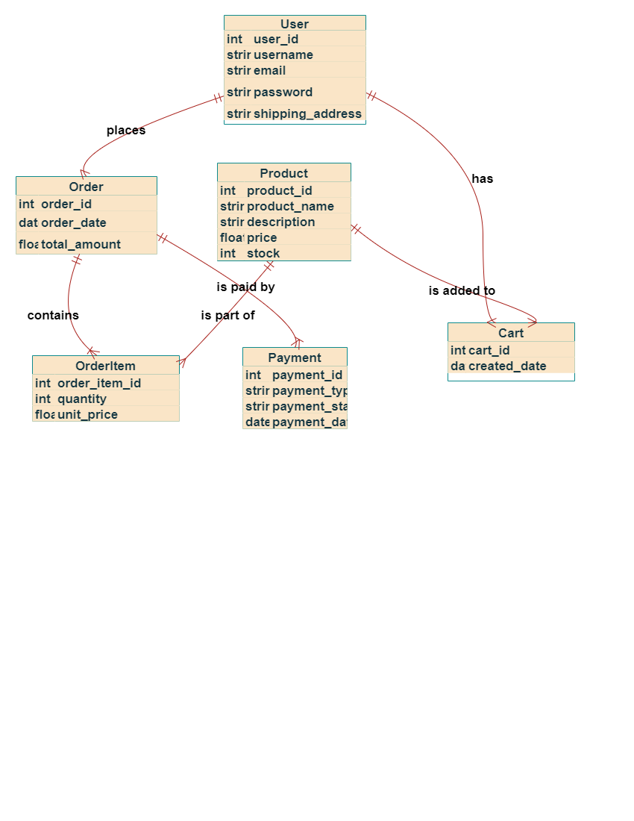
Database Design Of E-commerce Platform

Slide 9
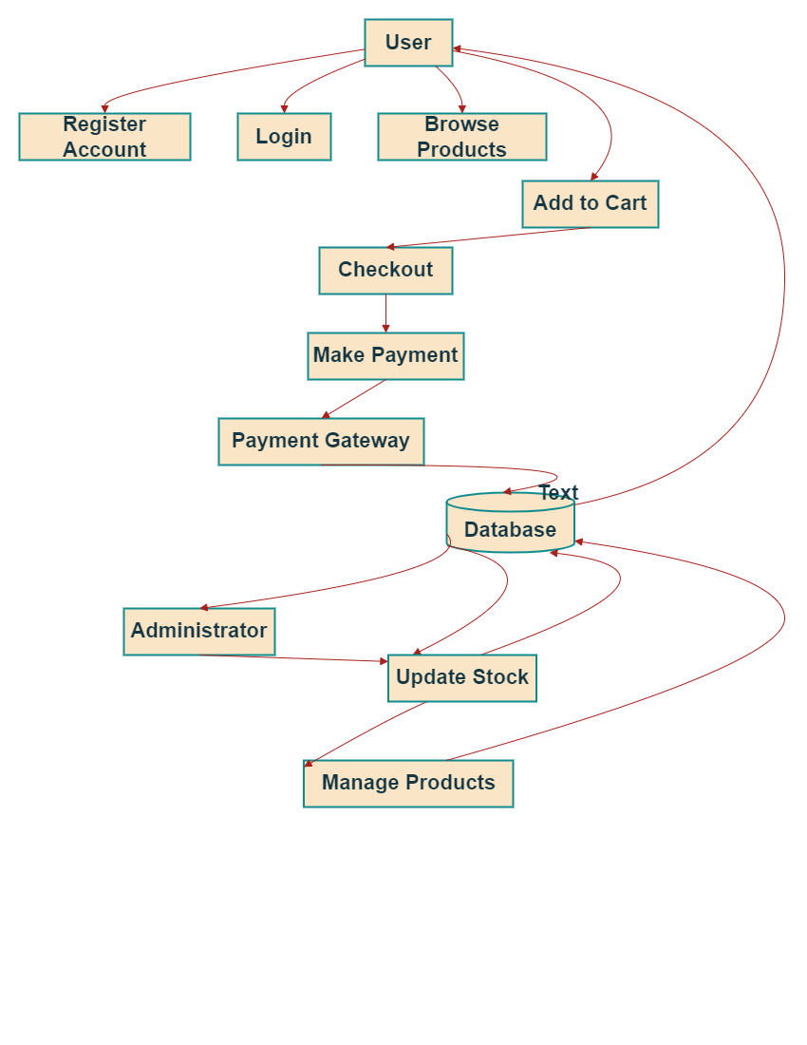
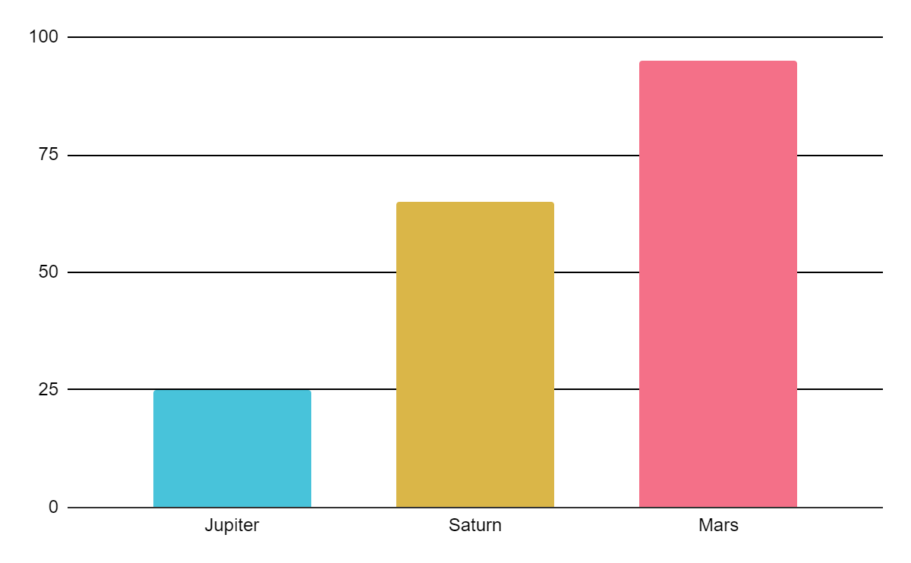
Workflow Of E-commerce Platform

Slide 10
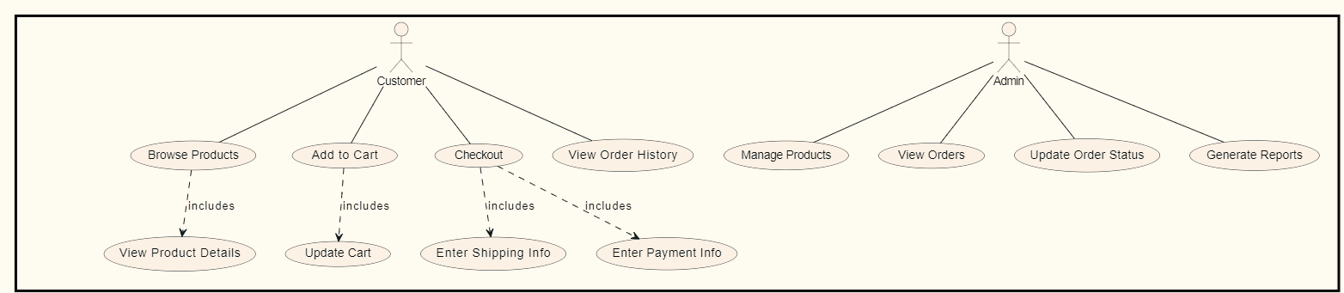
Use Case Diagram of E-commerce

Slide 11
Output
Dashboard
Registration
Product Information
Show Cart
make payment
Bill generating

Slide 12
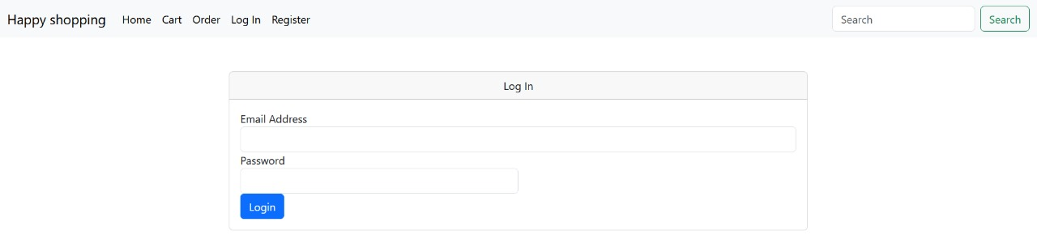
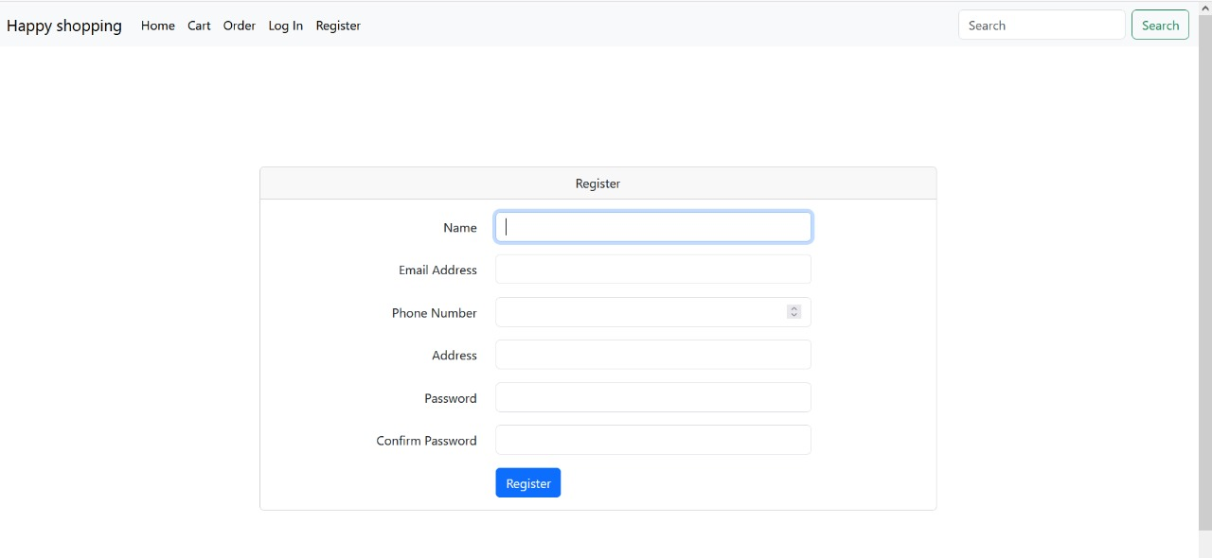
Dashboard:
Registration:

Slide 13
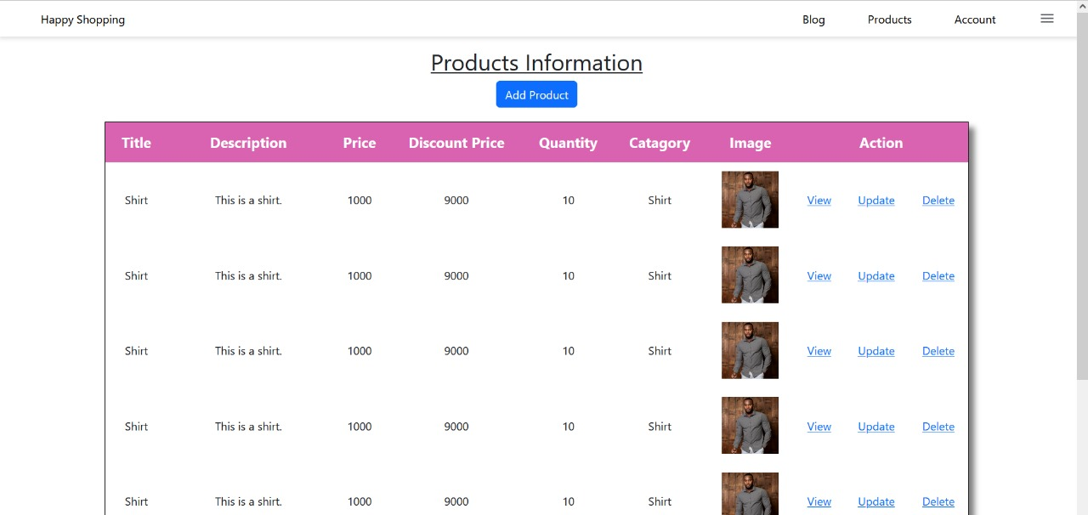
Product information:

Slide 14
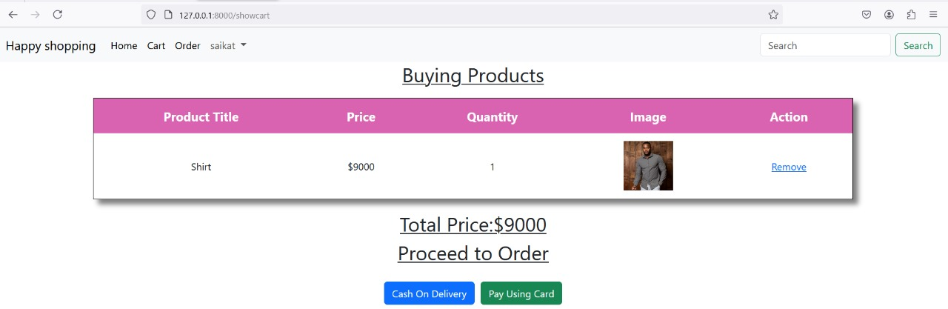
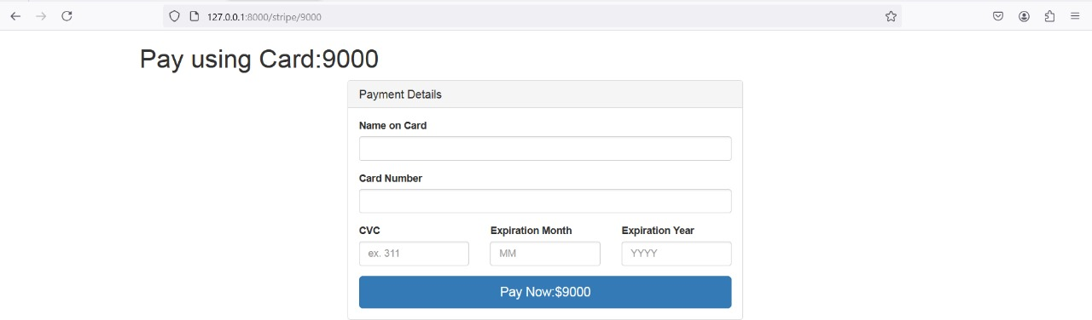
Show Cart:
Make Payment:

Slide 15
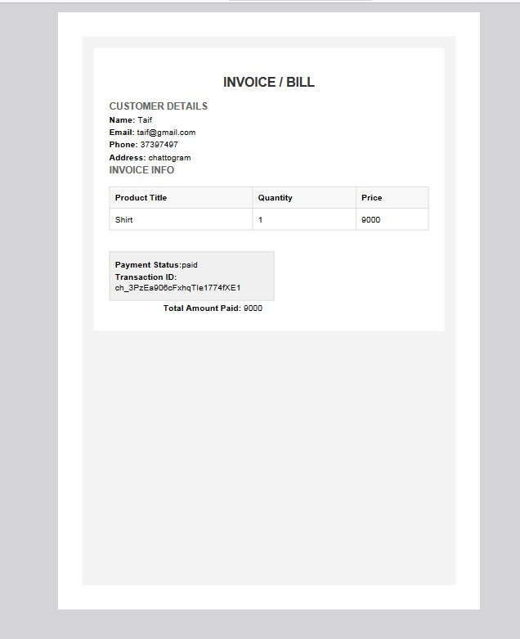
Bill Generating:

Slide 16
Limitations & Future works
Limitations
High competition makes it hard for businesses to stand out.
Security risks, such as data breaches, pose threats to customer trust.
Technical complexity can be a challenge, especially for small businesses
Future Works
AI-driven personalization to enhance customer experience.
Blockchain integration for more secure payment systems
Social commerce integration to better connect with customers on social media.

Slide 17

Conclusion
E-commerce platforms have made it easier for businesses to reach customers and grow online. While they face challenges like competition and security risks, they offer many benefits. With future improvements in technology, such as AI and blockchain, these platforms will become even more secure and personalized, helping businesses succeed in the online world.

Slide 18
Thanks!
Do you have any questions? sttr07@gmail.com
+88001879123456
Happy Shopping

